Slide 1
West Coast Umpire Camps 2021 Virtual Clinic
Crew Chief Wisdom
January 31, 2021

Slide 2
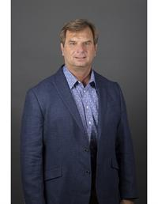
Jeff Henrichs
27 yrs NCAA
7 College World Series
Big 12 / Pac 12 / WCC / MEC tourneys
2009 IBAF World Cup – Europe
2016 Team USA vs Japan (in Japan)
10 yrs MiLB
American League Spring Training
1993 call-up

Slide 3
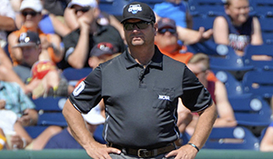
Jeff Henrichs
Instructor –
Joe Brinkman Umpire School
Black & Blue Umpire Camp
Mid-America Umpire Camp

Slide 4
Being a Good Crew Chief

Slide 5
UmpsCare
Ticket Program: provide VIP experiences to underserved youth, children battling illness, kids in foster care, and military families.
Hospital Program: deliver smiles and a furry friend to young patients in need.
Scholarship Program: help youth adopted late in life achieve their dreams of going to college

Slide 6
UmpsCare
https://give.UmpsCare.com/WCUC
https://westcoastumpirecamps.com

